Slide 1
Chapter 3
Wireless Network Principles
Contents
Wireless Basics
Frequency Allocation and Regulation
Antennas
Signal Propagation
Multiplexing
Modulation

Slide 2
Wireless Basics
Wireless Network Principles
They interconnect devices without using wires
They use the air as the main transmission medium.
Wireless networks are enjoying widespread public approval with a rapidly increasing demand.
The increase in the number of cellular phones, palm pilots, PDAs, laptops, notebooks, and other handheld devices is phenomenal.
To meet this demand, mobile communications technologies are emerging with digital speech transmission and the ability to integrate cordless systems into other networks

Slide 3
Wireless Basics
Wireless Network Principles
Wireless communication systems consist of three basic elements:
Transmitters that generate and send signals,
Antennas that radiate the electromagnetic energy generated by the signals into the air and also collect electromagnetic energy from the air.
Receivers that receive and process the signals
Transmitters and receivers are on same device, called transceivers

Slide 4
Wireless Basics
Wireless Network Principles
The unique features of wireless networks are:
The bandwidths, and consequently data rates, of communication channels are restricted by government regulations.
The government policies allow only a few frequency ranges for wireless communications.
The communication channel between senders/receivers is often impaired by noise, interference and weather fluctuations.
The senders and receivers of information are not physically connected to a network.
Thus the location of a sender/receiver is unknown prior to start of communication and can change during active communication.

Slide 5
Wireless Network Principles
Wireless Basics
Wireless Network Classification

Slide 6
Wireless Basics
Wireless Network Principles
Factors in designing wireless networks
Factor | Why important
Applications Supported | Most data applications require higher QoS than voice
Frequency Allocations | Need to know what frequency range to operate. May need licenses to operate in several ranges
Location Services | Essential because the users of mobile services change their location (e.g., a cellular phone). Also important for 911 calls.
Multiple Access Mechanisms | How users can share the same medium without interfering with ach other
Antennas and Propagation | Help in understanding the type of errors and how to deal with them

Slide 7
Wireless Network Principles
Frequency Allocations and Regulations
Wireless communications use the “radio frequency (RF)” spectrum for transmitting and receiving information.
The radio spectrum in fact represents the various frequencies supported by air and is a natural physical phenomenon.
This spectrum includes radio waves, radar waves, microwaves, infrared waves, and X-rays.
There is a correlation between wavelength and distance – higher frequencies do not travel far, due to media resistance
Frequency allocation means the process of assignment of specific frequency ranges for particular uses and services.
basically, it manages and control by regulatory body like Federal communications Commission in USA and International Telecommunication Union for global service.

Slide 8
Wireless Network Principles
Frequency Allocations and Regulations
Currently the process of frequency allocation is accomplished at two level.
1. International level:
ITU allocate frequency band for global service like aviation, maritime, satellite communication, etc.
2. National level:
Regulatory body like FCC at the country level allocate frequency for national use.
At present, telecommunications is considered to be technically feasible at frequencies as high as 300 GHz but many wireless systems, as we will see, operate in the 0.5 to 2 GHz zone.

Slide 9
Wireless Network Principles
Frequency Allocations and Regulations
Several factors are usually considered while allocating frequencies for wireless.
First, the cost of components increases as you go to higher frequencies.
Second, signal losses also increase as frequencies increase. These two factors are unfavorable to higher frequency ranges.
the third factor favors higher frequencies: communication systems at lower frequencies are disrupted regularly by man-made noise such as electrical motors, car ignition, and domestic appliances.
Yet another factor is the bandwidth needed by each user

Slide 10
Wireless Network Principles
Frequency Allocations and Regulations
The common frequency range at present, as stated previously, is in the 0.5 to 2 GHz range.
Despite the problems with interference and noise, the lower frequency bands are used more often, for two main reasons:
There is less loss on lower frequencies and travel long distance
and it is cheaper to produce lower frequency waves

Slide 11
Wireless Network Principles
Frequency Allocations and Regulations
General Frequency Ranges
Although radio frequencies can range from 0 to 500 GHZ or higher, the ITU (International Telecommunication Union) concentrates on radio frequencies that range from 9 KHz to 400 GHZ
Within this range, the following are broad categories:
Broadcast radio frequency range (30 MHz to 1 GHz). This is suitable for omnidirectional applications such as general radio.
Microwave frequency range (1 GHz to 40 GHz). This frequency range is suitable for directional beams and is used for point-to-point transmission in several applications such as satellite communications.
Infrared frequency range (roughly 3x10¹¹ to 2x10¹⁴ Hz), useful in local point-to-point multipoint applications within confined areas.

Slide 12
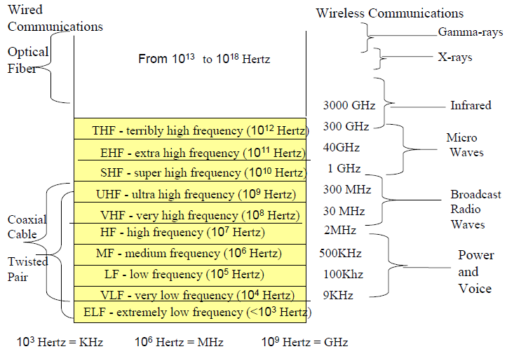
Wireless Network Principles
Frequency Allocations and Regulations
General Frequency Ranges
Fig. Radio Frequency spectrum

Slide 13
Wireless Network Principles
Frequency Allocations and Regulations
Broadcast Radio (30 MHz to 1 GHz) Frequency Band
It’s used in broadcast radio and consists of VHF and part of the UHF band that goes from 30 MHZ to 1GHz.
It’s Typical applications include FM radio and UHF and VHF television.
It’s a congested frequency band and many new applications are emerging in this band.
Due to new applications, the frequency range is expanded frequently.
Due to the low frequency range, the antennas in this band are omnidirectional, i.e., they broadcast in every direction
This is the main differentiator from microwave communications in which the communication is directional
The antennas for broadcast radio are not required to be dish-shaped and need not be rigidly mounted to a precise alignment

Slide 14
Wireless Network Principles
Frequency Allocations and Regulations
Microwave Frequency Band
used in satellite and terrestrial communications.
Satellite Microwave (1 GHz to 20 GHz, typically)
A satellite is a microwave relay station that is used to link two or more ground-based microwave transmitters/receivers.
The satellite receives transmissions on one frequency band (uplink), amplifies or repeats the signal, and transmits it on another frequency (downlink).
Satellites are used in a variety of ways:
From TV content provider to local TV
Long distance telephone transmission
For large private business such as IBM

Slide 15
Wireless Network Principles
Frequency Allocations and Regulations
Terrestrial Microwave (20 GHz to 40 GHz)
These wireless communications most commonly use a parabolic “dish,” typically 3 meters in diameter.
The dish is fixed rigidly and focuses on a narrow beam of transmission.
It achieves line-of-sight transmission to the receiving antenna.
To facilitate line-of-sight transmission over longer distances, the dishes are located at substantial heights above ground level
They are used in long-haul telecommunications service, i.e., instead of fiber or coax cables (e.g. WLAN, Closed Circuit TV)
The main advantage of microwave is that it requires fewer repeaters; but its limitation is that it only works on line of sight.
The most common frequency band used in terrestrial microwave is 4 GHZ. This can deliver up to 200 Mbps to end users.

Slide 16
Wireless Network Principles
Frequency Allocations and Regulations
Infrared Frequency Band
These waves operate in the terribly high frequency (THF) range that covers 300 GHz to 3000 GHz.
They do not penetrate solid objects such as walls.
Due to this limitation they are used in point-of-sight (POS) applications such as TV remote control, garage door openers and other remote control devices

Slide 17
Wireless Network Principles
Frequency Allocations and Regulations
There are basically two approaches in using wireless frequencies:
Licensed network: operate on frequencies for which the user or service provider must have license, typically issued by regulatory authority.
Applications: cellular network, TV and Radio broadcasting
Benefits:
Reduce interference: exclusively use of frequency
High reliability: network quality and coverage

Slide 18
Wireless Network Principles
Frequency Allocations and Regulations
Drawbacks:
Costly: fees can be significant to get license.
Less flexibility: users or provider must follow strict regulatory guidelines.
2. Unlicensed Network: users doesn’t need license to operate in frequency band.
Application: WIFI, Bluetooth, Cordless phones
Benefits:
Low cost: no fee to get license
Flexibility: easy to set up own wireless network
Drawbacks:
Higher Interference: shared access to unlicensed band leads to increase the tendency of interference.
Variable quality: service quality can be unpredictable.

Slide 19
Wireless Network Principles
Frequency Allocations and Regulations
Why Low Frequencies are More Congested
Lower frequencies are usually much more congested and contested than higher ones.
Within a frequency band, the lower spectrum of frequencies is used more often than higher ones. There are two main reasons for this:
Lower frequencies suffer less loss and travel farther.
It is cheaper to produce lower-frequency waves. Very simple antennas of your cellular phone or laptop can generate signals in the lower frequency. But you need powerful antennas for higher-frequency waves.
The main disadvantage of lower frequencies is that they suffer interference from nature (e.g., rain, thunderstorms) as well as other neighbors who also insist on using the same frequency ranges.

Slide 20
Wireless Network Principles
Frequency Regulations
Low frequencies from 9KHz to 300 MHZ are in high demand (especially VHF: 30-300 MHZ) because they can be supported without expensive antennas and can travel far.
The lower frequencies are used frequently for broadcast radio and are thus more in demand. In addition, cellular phones also use lower frequencies (around 900 MHz).
Due to this popularity, regional, national, and international issues in regulating frequencies occur more commonly concerning lower frequencies.
In fact, lower frequencies are auctioned in several places, especially in Europe. In particular, auctions for 3G cellular frequency licenses have been very lucrative.
Frequency regulation refers to enforcing the rules and policies set during frequency allocation. It ensure the user follow established guidelines for transmission power, frequency use and interference avoidance.

Slide 21
Wireless Network Principles
Frequency Regulations
There are different types of procedures for military, emergency, air traffic control, etc. Some frequency bands are reserved for these uses.
Different agencies license and regulate the frequency allocations. Examples are:
Federal Communications Commission (www.fcc.gov) that regulates frequency allocations in the US
The British www.open.gov.uk/radiocom that is used in the UK
European Telecommunications Standards Institute (ETSI) for European countries
Radio Communications Bureaus to handle frequency interference across national borders.
ITU (International Telecom Union). Headquartered in Geneva, consisting of several sectors such as ITU-R (radio communications), ITU-T (standards), and ITU-D. (Development).
The National Telecommunications and Information Administration (NTIA – www.ntia.gov), is part of the United States Commerce Department. Reading Assignment!

Slide 22
Wireless Network Principles
Location Management in Wireless Networks
Main Drivers and Approaches
Wireless systems have to keep track of the users as they move around
Because, the cellular network needs to know where you are if it has to direct a call to you.
In addition, WLANs also need to know if you move from one LAN cell to another. Other drivers are:
Commercial drivers: Location-sensitive information can be bundled into mobile commerce and other application as a value-added service.
Regulatory drivers: Regulatory agencies are requiring mobile operators to provide accurate locations for emergency purposes and public safety
Technological drivers: Deployment of 2.5G and 3G networks and better handsets such as Communicators and Media Phones enable new services that could include location as a value-added service

Slide 23
Wireless Network Principles
Location Management in Wireless Networks
Techniques for location management
Cell ID-based location. This is the oldest and by far the most commonly used technique. In this case, a mobile user is assigned an ID of the cell that the user is in. This Cell ID is stored in a database. As the user moves from one cell to another, the location database is updated accordingly.
Other location services. Although Cell ID-based services work quite well, they are not very accurate because they can only tell which cell a user is in. Other techniques include Assisted Global Positioning System (AGPS), Angle of Arrival (AOA), and variants of Time of Arrival (TOA).

Slide 24
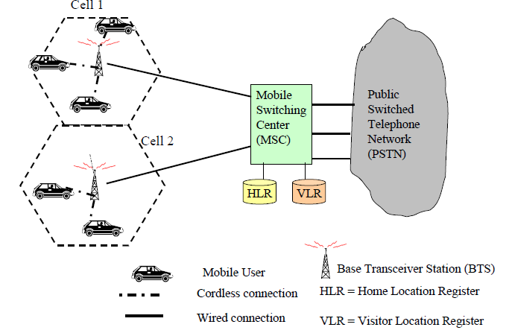
Wireless Network Principles
Location Management in Wireless Networks
Fig. A Cellular Communication Network

Slide 25
Wireless Network Principles
Location Management in Wireless Networks
Other techniques for location management
Angle of Arrival (AOA) the angle at which radio waves from your device “attack” an antenna is used to calculate the location of the device.
In reality the angle of arrival is observed at multiple (about 3) base stations. Knowing the arrival angle at the three base stations, the location can be calculated
Network Assisted Global Positioning System (AGPS)
a GPS chip is installed inside a phone to track the location of the user. The mobile phone is also equipped with an antenna that receives signals being sent from the US’s GPS satellites.
The signals originate from the satellites at precisely the same time and propagate toward earth at the speed of light. When the mobile user device receives the signal, it calculates its location based on the difference in time it takes for each of the satellites’ signals to reach the mobile user’s special phone.

Slide 26
Wireless Network Principles
Location Management in Wireless Networks
Other techniques for location management
Time of Arrival (TOA)
In this case, the time taken between the device and the antenna is used to calculate the location of the device.
Instead of time taken, some approaches use power dissipated

Slide 27
Wireless Network Principles
Antennas
An antenna is an electrical conductor or system of conductors to send/receive electromagnetic waves in wireless communication system.
Transmission radiates electromagnetic energy into space and reception collects electromagnetic energy from space.
In two-way communication, the same antenna can be used for transmission and reception.
Antenna helps to convert electrical signal from transmitter into radio wave and convert radio wave back into electrical signals at the receiver.
Radiation patterns are the graphical representation of showing how antenna radiate the power into the free space. This pictorial method is used t illustrate the strength of radiation in various direction around antenna.
There are three types of antennas produce different radiation patterns.

Slide 28
Wireless Network Principles
Antennas
1. Isotropic (omnidirectional) transmissions that radiate power equally in all directions. This happens in lower frequency ranges and is used in broadcast radio communications.
Omnidirectional antennas waste frequencies because they keep transmitting in all directions even if all users lie only in one direction.
Omnidirectional strategies attempt to overcome environmental challenges by simply increasing transmit power.
This is not a good solution because it generates greater interference for other users.
2. Sector antenna:
Provide coverage over a specific sector angle, commonly used in cellular towers to cover specific areas.

Slide 29
Wireless Network Principles
Antennas
3. Directional transmissions that radiate power in one direction.
They are common in higher frequency ranges
Preferential transmission and reception directions can be predefined between senders and receivers.
This results in more power being focused in the preferred direction, and less power in other possibly interfering directions.
These antennas have the natural limitation that if an object moves out of the directional beam, it cannot receive the signal.
Common examples of directional antennas can be found in satellite communications.

Slide 30
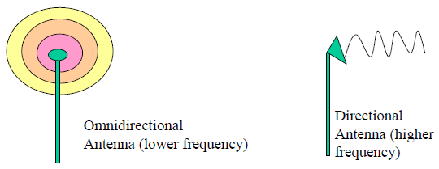
Wireless Network Principles
Antennas
Naturally, it is desirable to develop antennas that can provide directional services to follow the customers as they move around.
This is done through smart antennas
Fig. antenna types
Antenna gain is a measure of directionality of antennas
It simply represents the power output, in a particular direction, compared to that produced in any direction by a perfect omnidirectional antenna with isotropic radiation patterns.

Slide 31
Wireless Network Principles
Smart Antennas
The idea is to propagate signals to follow objects as they move around or to choose the transmission directions that minimize noise.
A smart antenna system combines multiple antenna elements with processing capabilities to automatically optimize its radiation/reception pattern to adjust to the environment.
Generally co-located with a base station, a smart antenna system intelligently uses an antenna array (many antenna elements) to transmit and receive in an adaptive manner.
In other words, such a system can automatically change the directionality of its radiation pattern to follow user populations as they move around.
This can dramatically increase the performance characteristics (such as capacity) of a wireless system.

Slide 32
Wireless Network Principles
Smart Antennas
Another main benefit of smart antennas is improvement in transmission quality because they can increase desired signal power and reduce interference as needed
So smart antenna means advanced antenna system that allow adaptively control the direction and shape of radiation pattern.
This means, smart antenna can dynamically adjust the radiation pattern based on the user location, signal quality and interference level unlike traditional antenna which has fixed radiation pattern.
This helps to improve the coverage area, capacity and data rate.
There are two type of smart antenna.
1. Switched-beam systems with a number of fixed beams at an antenna site – the beam with least interference and best signal strength is chosen.
2. Adaptive array antennas with an array of antennas that can adjust patterns based on noise, interference, and location of objects

Slide 33
Wireless Network Principles
Smart Antennas: switched-beam
A switched-beam antenna system has multiple predefined beams pointing in different directions.
The system selects the beam that provides the strongest signal or best quality for current user.
These antenna systems detect signal strength, choose from one of several predetermined fixed beams and switch from one beam to another as the mobile device moves around a cell.
These systems are very easy to build because the beams already exist – you only need to switch from one to another.
Switched beam antenna is not fully adaptive.
Main limitation is:
The beams of the antenna system can only be chosen from already available positions
new and arbitrary directions cannot be created on the fly.

Slide 34
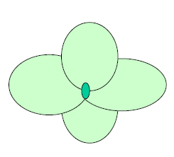
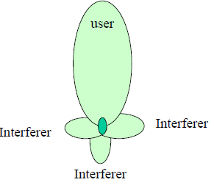
Wireless Network Principles
Smart Antennas: switched-beam
Another disadvantage is that the subscriber’s signal strength varies as the user moves from the center of the beam to the edge of the coverage region of that beam
Despite these limitations, switched beam systems are popular because of their low cost and the few interactions needed with the base station receiver.
Thus they do not add extra burden to the base stations.
Fig. two types of smart antennas (Switched Beam and Adaptive Array)

Slide 35
Wireless Network Principles
Smart Antennas: adaptive array
Adaptive array antennas are use a variety of new signal-processing algorithms to locate and track various types of signals of the moving devices to minimize interference and maximize signal strength.
adaptive system provides optimal gain while tracking and minimizing interfering signals compared to switched beam.
Adaptive array are fully adaptive and can dynamically adjust their beam pattern in real time based on user’s location, interference level, signal quality and other factor.
For any type of antenna there is three basic key parameters:
Gain : measure how much power is directed in particular direction compare to omnidirectional.
Bandwidth: the range of frequency
Polarization: the orientation of electron fields.

Slide 36
Wireless Network Principles
Signal Propagation
Propagation means a way radio wave travel from transmitter antenna to receiver antenna through various paths and mediums.
Generally, there are three type of signal propagations:
Line of sight propagation:
The radio wave travel directly from transmitter to receiver without significant obstruction.
Its operate at high frequency with the range of more than 30MHz.
The drawback of this propagation is barrier by obstacle like building, large tree and etc.
Application: cellular network, WIFI, satellite communication, TV broadcasting and etc.
2. Ground wave propagation:
Radio wave travel along the earth surface/curvature.
Its operate at lower frequency with the range of less than 3MHz. Example:- AM radio

Slide 37
Wireless Network Principles
Signal Propagation
3. Sky wave propagation:
The radio wave reflected off ionosphere (upper layer of earth atmosphere) back down to earth.
Its operate at lower frequency with the range of 3MHz-30MHz.
The drawback of this propagation is based ionosphere which is depend on the season the atmosphere.
Application: shortwave radio for international broadcast like BBC, military communication and maritime and amateur radio.
Currently, most applications are use line of sight propagation because a lot of applications have high bandwidth like more than 30MHz.

Slide 38
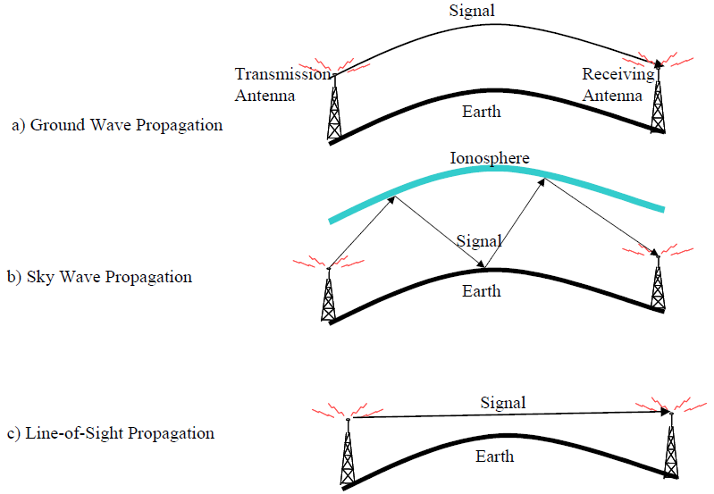
Wireless Network Principles
Signal Propagation
Fig. Propagation Modes

Slide 39
Wireless Network Principles
Multiplexing
It is the set of techniques that allows the simultaneous transmission of multiple signals across a single data link.
Multiplexing is done using a device called Multiplexer (MUX) that combine n input lines to generate one output line i.e. (many to one).
At the receiving end a device called Demultiplexer (DEMktX) is used that separate signal into its component signals i.e. one input and several outputs (one to many).

Slide 40
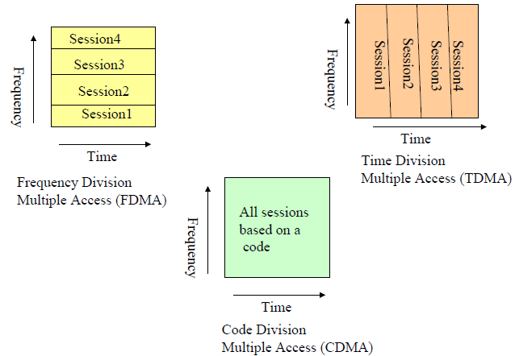
Wireless Network Principles
Multiplexing: Types of multiplexing
Frequency Division Multiplexing (FDM)
Time Division Multiplexing (TDM)
Code Division Multiplexing (CDM)
Space Division Multiplexing (SDM)
Fig. multiple access techniques

Slide 41
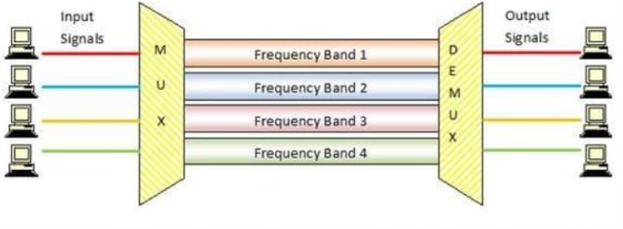
Wireless Network Principles
Multiplexing: Frequency division Multiplexing (FDM)
Each signal is assigned a unique frequency range within the bandwidth and all signals are transmitted at the same time but in separate frequency channel.
It’s one of the simplest and oldest schemes.
FDM’s most common applications are traditional radio, television broadcasting , mobile or satellite stations, cable television
Fig. Frequency division multiple access techniques

Slide 42
Wireless Network Principles
Multiplexing: Frequency division Multiplexing (FDM)
Advantages of FDM
The concept of frequency division multiplexing (FDM) applies to both analog signals and digital signals.
lt facilitates you to send multiple signals simultaneously within a single connection.
Disadvantages of FDM
It is less flexible.
It is not very efficient because a channel could be wasted if no one in that channel is talking

Slide 43
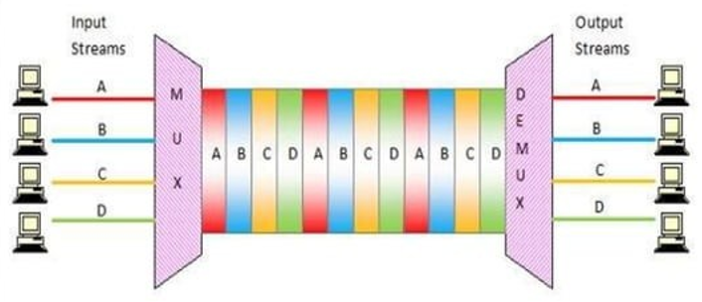
Wireless Network Principles
Multiplexing: Time division Multiplexing (TDM)
Each signal is assigned a unique time slot, allowing multiple signal to use the same frequency sequentially.
TDMA thereby makes more efficient use of available bandwidth than FDMA. Example:- digital telephony
There are two type of TDM:
Synchronous TDM: time slot are pre-assigned, even if not all are used.
Asynchronous TDM: time slots are dynamically assigned based on demand, improve efficiency.
Fig. Time division multiple access techniques

Slide 44
Wireless Network Principles
Multiplexing: Time division Multiplexing (TDM)
Advantages of TDM
It facilitates a single user at a time.
It is less complicated and has a more flexible architecture
Disadvantage of TDM
It isn’t easy to implement

Slide 45
Wireless Network Principles
Multiplexing: Code division Multiplexing (CDM)
Each signal is assigned a unique code, allowing all signals to be transmitted over the same frequency simultaneously.
Signals can be separated at the receiving end by using the unique code associated with each sender.
CDM technology separates users by assigning them digital codes within the same broad spectrum.
The receivers only tune to those codes and ignore the others.
The assigning of codes to different users is also known as spread spectrum, a technique very heavily used in wireless LANs as well as cellular networks
It is mainly used in Cell Phone Spectrum Technology (2G, 3G etc.) and CDMA.

Slide 46
Wireless Network Principles
Multiplexing: Code division Multiplexing (CDM)
Advantages of CDM
It is highly efficient
It faces fewer inferences
Disadvantages of CDM
The data transmission rate is low
It is complex

Slide 47
Wireless Network Principles
Multiplexing: Space division Multiplexing (SDM)
SDM is a method in which we split a communication channel into multiple different physical location and allocated each stream of data onto each of the location.
It is a combination of FDM and TDM.
It passes messages or data-parallel with the use of specific frequency at a specific. It means a particular channel will be used against a specific frequency band for some amount of time.
It is used in GSM (Global Service for Mobile) Technology

Slide 48
Wireless Network Principles
Multiplexing: Space division Multiplexing (SDM)
Advantages of SDM
In SDM, the data transmission rate is high
It uses Time and Frequency bands at its maximum potential
Disadvantages of SDM
An inference may occur
It faces high inference losses

Slide 49
Modulation (Signal Encoding)
Wireless Network Principles
Modulation is the fundamental technique in telecommunications and electronics, where message signal is transformed to allow it to be transmitted effectively over a channel.
It’s a schema to convert digital to analog signal and vice versa.
It is the process of altering a carrier wave properties (amplitude, frequency, phase) to encode information from message signal for transmission.
This technique allows signal to travel over communication channels efficiently, enhance resilience to noise and interference and enable the use of multiplexing.

Slide 50
Modulation
Wireless Network Principles
Modulation and demodulation
analog
baseband
signal
digital
data
digital
modulation
analog
modulation
101101001
radio transmitter
radio
carrier
analog
baseband
signal
digital
data
analog
demodulation
synchronization
decision
101101001
radio receiver
radio
carrier

Slide 51
Wireless Network Principle Modulation and Demodulation
Demodulation means the process of extract and recover original information from a modulated carrier wave at the receiver end.
It is the reverse of modulation and is necessary to retrieve the transmitted information for use.
Demodulation techniques vary depending on the type of modulation used.
There are two type modulation.
Digital modulation
Take limited number of value range.
2. Analog Modulation:
Take infinite number of value range.

Slide 52
Modulation
Wireless Network Principles
Digital modulation
Modulation of digital signals known as Shift Keying
Amplitude Shift Keying (ASK):
very simple and low bandwidth requirements
Binary data modulate the amplitude of carrier
Wave. 1 bit represent high amplitude and 0 bit
Represent low amplitude.
Frequency Shift Keying (FSK):
needs larger bandwidth and the frequency of
the carrier wave is changed between discrete value
To represent binary data. Example:- radio and Bluetooth
Phase Shift Keying (PSK):
more complex and robust against interference
Carrier wave’s phase is changed to represent data.
1
0
1
t
1
0
1
t
1
0
1
t

Slide 53
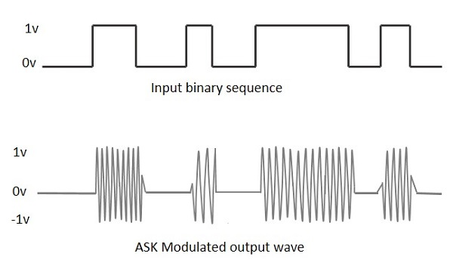
Modulation
Wireless Network Principles
Amplitude-shift keying (ASK) is a form of amplitude modulation that represents digital (binary) data as variations in the amplitude of a carrier wave.
The 0 and 1 bits are represented by the height of the amplitude.
Simple, simple but is susceptible to sudden gain changes due to noise and attenuation consequently not heavily used in wireless
E.g. 5 volts may be used to represent bit 0 and 9 volts may be used to represent bit 1.

Slide 54
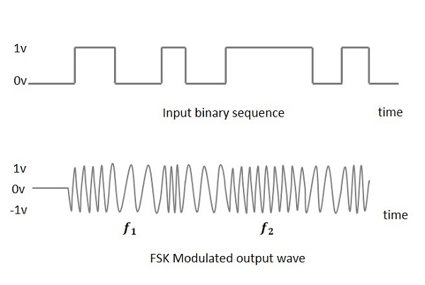
Modulation
Wireless Network Principles
Frequency Shift Keying (FSK) is the digital modulation technique in which the frequency of the carrier signal varies according to the digital signal changes.
The 0 and 1 bits are represented by two different frequencies
The output of a FSK modulated wave is high in frequency for a binary High input and is low in frequency for a binary Low input. The binary 1s and 0s are called Mark and Space frequencies.
FSK is less susceptible to errors than ASK and is used for high-frequency (3 to 30 MHz) radio transmissions.

Slide 55
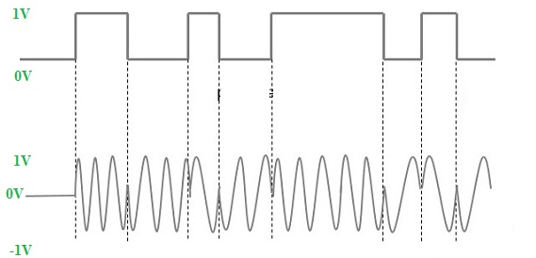
Modulation
Wireless Network Principles
Phase Shift Keying (PSK)
The phase of the carrier signal is changed by varying the sine and cosine inputs at a particular time.
PSK technique is widely used for wireless LANs, bio-metric, contactless operations, along with RFID and Bluetooth communications
Fig. phase shift keying

Slide 56
Modulation
Wireless Network Principles
Analog Modulation:
There are three type of analog modulation. Such as:-
Amplitude modulation (AM):
The amplitude of the carrier wave varies according to the message signal.
Application: used in AM radio broadcasting and early television transmission
2. Frequency Modulation (FM):
The frequency of the carrier wave varies according to the message signal.
Application: used in FM radio broadcasting and television audio signal

Slide 57
Modulation
Wireless Network Principles
3. Phase Modulation (PM):
The phase of the carrier wave varies according to the message signal.
Application: used in digital communication and basis for techniques like phase shift keying.

Slide 58
Wireless Network Principles
The End!

